Slide 1
NPTEL
Video Course on Machine Learning
Professor Carl Gustaf Jansson, KTH
Week 6 Machine Learning based
on Artificial Neural Networks
Video 6.6 Hebbian Learning and Associative Memory

Slide 2
Structure of Lectures in week 6
We are here
L1 Fundamentals of
Neural Networks
McCulloch and Pitts
Supervised learning L2 Perceptrons Linear L6 Hebbian Learning and
- classification classification Associative Memory
- regression
L3 och L4 Feed forward multiple layer Reinforcement
networks and Backpropagation learning Unsupervised learning
L5 Recurrent Neural Sequence and L7 Hopfield Networks and
Perception Networks (RNN) temporal data Boltzman Machines
L8 Convolutional Neural
Networks (CNN)
L9 Deep Learning and
recent developments
Development of
the ANN field
L10 Tutorial on assignments

Slide 3
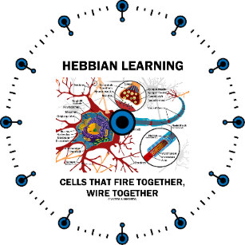
Hebbian Learning (1947)
Hebbian Learning theory is a neuroscientific theory claiming that an increase in synaptic efficacy arises from a presynaptic cell's repeated and persistent stimulation of a postsynaptic cell. The theory was introduced by Donald Hebb in his 1949 book The Organization of Behavior. The theory is also called Hebb's rule, Hebb's postulate or Cell Assembly theory.
Hebb expressed himself as follows:
´Let us assume that the persistence or repetition of a reverberator activity (or "trace") tends to induce lasting cellular changes that add to its stability. ... When an axon of cell A is near enough to excite a cell B and repeatedly or persistently takes part in firing it, some growth process or metabolic change takes place in one or both cells such that A's efficiency, as one of the cells firing B, is increased.´
As it turns out neuron A has to fire slightly before B (temporal precedence) and not fully in parallell to manifest the causality relation. This elaboration of Hebb´s work is called spike-timing-dependent plasticity (STDP).

Slide 4
Hebbian Learning in an
Artificial Neural Network
The theory is often summarized as "Cells that fire together wire together¨.
It is an attempt to explain synaptic plasticity, the adaptation of brain neurons during the learning process. In an ANN setting, the plasticity is implemented through adaption of weights.
Hebb’s Law can be represented in the form of two rules:
If two neurons on either side of a connection (synapse) are activated synchronously, then the weight of that connection is increased.
If two neurons on either side of a connection (synapse) are activated asynchronously, then the weight of that connection is decreased.
Hebb’s Law provides the basis for unsupervised learning. Learning here is a local phenomenon occurring without feedback from the environment.

Slide 5
Hebbian Learning algorithm
Step 1: Initialization.
Set initial synaptic weights and thresholds to small random values in the interval [0, 1].
Step 2: Activation.
Compute the postsynaptic neuron output from the presynaptic inputs element Xi j in the data-item X j
Y j = if (Sum Xi j*Wi j –T)>=0 then 1 else 0.
i = 1..n , i refers to inputs to postsynaptic neuron from presynaptic neurons
j refers to the training instance (data-item)considered
Τ is the threshold value of neuron
Step 3: Learning – the activity product rule
Update the weights in the network. The weight correction is determined by the activity product rule:
Wi j+1 = Wi j +α * Y j*Xi j where α is the learning rate parameter
Step 4: Iteration. go back to Step 2.

Slide 6
Y j = if (Sum Xi j*Wi j –T)>=0 then 1 else 0. i=1..n Wi j+1 = Wi j +a * Y j*Xi j
Example
Inputs Iterations J =0,1,2….
x1 W1
Weights are initiated to 1 1 1 1
Threshold = 2 a = 1
x2
The first two training instances are:
W3 1 0 1 0
x3 1 0 1 0 W4
x4
W2
T
Y

Slide 7
Example – first iteration
Y j = if (Sum Xi*Wi j –T)>=0 then 1 else 0.
i=1..n
Wi j+1 = Wi j +α * Y j*Xi j
Sum =1*1+0*1+1*1+0*1 -2 =0 >=0
=> Y0 = 1
Inputs α =1
J=0
x1=1 W1=1
x2=0
W3=1
x3=1 Y0=1
W4=1
x4=0
W2=1
= a *xi*y0
Τ=2

Slide 8
Example – second iteration
Y j = if (Sum Xi*Wi j –T)>=0 then 1 else 0.
i=1..n
Wi j+1 = Wi j +α * Y j*Xi j
Sum =1*2+0*1+1*2+0*1 -2 =2 >=0
=> Y1 = 1
Inputs α =1
J=1
x1=1 W1=2
x2=0
w3=2
x3=1 Y1=1
w4=1
x4=0
W2=1
a *xi*y1
Τ=2

Slide 9
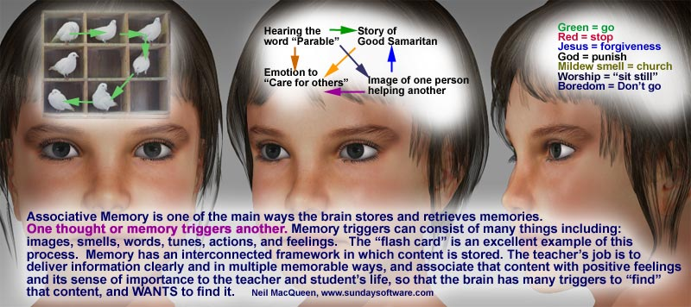
Associative memory
In psychology, associative memory is defined as the ability to learn and remember the relationship between unrelated items. This could include, for example, remembering the name of someone or the aroma of a particular perfume.
Associative memory is a declarative memory structure and episodically based.
A normal associative memory task involves the testing participants on their recall of pairs of unrelated items, such as face-name pairs.

Slide 10
Associative Memory (AM)
In artificial intelligence and machine learning, associative memory refers to a broad class of memory structures with mechanisms for storage and recall that can handle general patterns and patternmatching. Theoretically all kinds of structures and datatypes should be able to be handled in the same system. There is also a clear coupling to the area of content adressable memory (CAM) techniques.
In one end of the spectrum there are memorization of specific objects and situations and recall of these based on detailed but still partial or noisy descriptions.
In the other end of the spectrum there are analogical reasoning where structurally similar but domain un-related patterns can be recalled.
In the middle there are case based reasoning where subpatterns can trigger recall of larger patterns.
Central concepts are:
Similarity measures (spatial or temporal) and other topological aspects of the pattern space (valleys, hills, basins).
Optimality criteria and aspects of the search space (local minima/maxima, attractors etc.)
Ideally one could say that one wants a AM system that has as many stable well separated local minimas as one has memories to store.

Slide 11
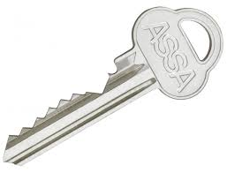
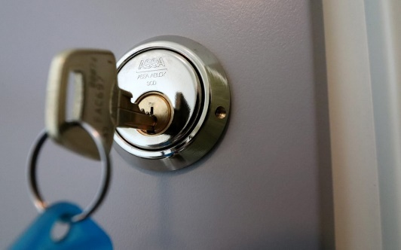
Two forms of Associative Memory
Auto-associative memory
Auto- associative memory also known as auto-association memory or auto-association networks, is any type of memory that enables one to retrieve a more complete object description from a partial description.
In more technical terms the input and output vectors have exactly the same form or synonymously that Xi and Yi has the same form for vectors X and Y.
Concrete examples are the restoration of imagery and speech fragments.
Hetero-associative memory
Hetero-associative memories, on the other hand, can retrieve not only object descriptions of the same form but potentially also a wider range of patterns still satisfying some measure of similarity with respect to a partial description.
In terms of vectors the input vector X and the output vector Ycan have different forms.

Slide 12
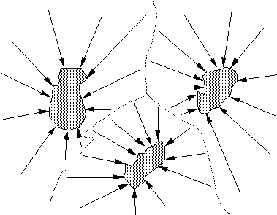
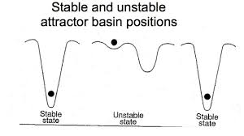
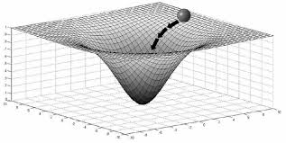
Attractors, Basins and Bifurcations
An Attractor is a state, toward which other states in the region evolve in time. Similarly, each attractor has a Basin, which is the surrounding region in state space such that all trajectories starting in that region end up in the attractor.
The basins belonging to different attractors are separated by a narrow boundary, which can have a very irregular shape. The appearance of such a boundary separating two attractors is called a Bifurcation.
For initial positions close to the boundary, small fluctuations can push the system either into the one or into the other basin, and therefore either into one or the other attractor. Close to a boundary, the system behaves chaotically but inside a basin it moves predictably towards its attractor.
Ideally one wants a AM system that has as many well separated basins as one has memories to store.

Slide 13
NPTEL
Video Course on Machine Learning
Professor Carl Gustaf Jansson, KTH
Thanks for your attention!
The next lecture 6.7 will be on the topic:
Hopfield Networks and
Boltzman Machines

